Slide 1

PART OF SPEECH
Ayu Pratiwi Ulfah, S.Hum., M.Hum.

Slide 2
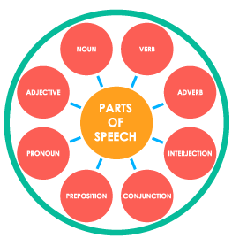

Slide 3
1. NOUN
A noun is a word for a person, place, thing, or idea. Nouns are often used with an article (the, a, an), but not always.
Proper Noun: always start with a capital letter.
Common Noun: man... house... happiness
Singular
Plural
Concrete
Abstract.

Slide 4
The young girl brought me a very long letter from the teacher, and then she quickly disappeared. Oh my!

Slide 5
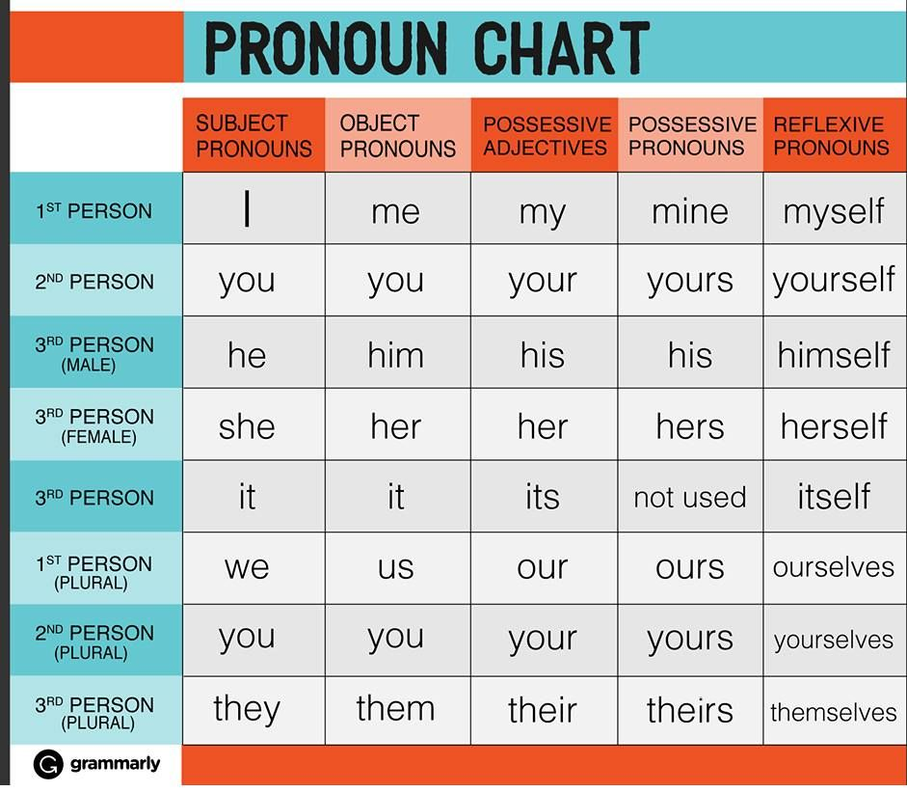
2. PRONOUN
A pronoun is a word used in place of a noun. A pronoun is usually substituted for a specific noun, which is called its antecedent.

Slide 6
Could you give me some money?
This is my bag.
This is mine.
This is yours.
I do it by myself.
The young girl brought me a very long letter from the teacher, and then she quickly disappeared. Oh my!

Slide 7
3. VERB
The verb in a sentence expresses action or being. There is a main verb and sometimes one or more helping verbs. ("She can sing." Sing is the main verb; can is the helping verb.)
Auxiliary verbs: are, am, is, was, were
The young girl brought me a very long letter from the teacher, and then she quickly disappeared. Oh my!

Slide 8
4. ADJECTIVE
An adjective is a word used to modify or describe a noun or a pronoun. It usually answers the question of which one, what kind, or how many. (Articles [a, an, the] are usually classified as adjectives.)
The young girl brought me a very long letter from the teacher, and then she quickly disappeared. Oh my!

Slide 9
5. ADVERB
An adverb describes or modifies a verb, an adjective, or another adverb, but never a noun. It usually answers the questions of when, where, how, why, under what conditions, or to what degree. Adverbs often end in -ly.
Example: gently... extremely... carefully... well
The young girl brought me a very long letter from the teacher, and then she quickly disappeared. Oh my!

Slide 10
6. PREPOSITION
A preposition is a word placed before a noun or pronoun to form a phrase modifying another word in the sentence. Therefore a preposition is always part of a prepositional phrase. The prepositional phrase almost always functions as an adjective or as an adverb. The following list includes the most common prepositions : by... with.... about... Until (by the tree, with our friends, about the book, until tomorrow)
The young girl brought me a very long letter from the teacher, and then she quickly disappeared. Oh my!

Slide 11
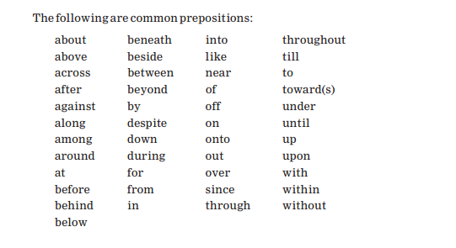

Slide 12
7. CONJUNCTION
A conjunction joins words, phrases, or clauses, and indicates the relationship between the elements joined. Coordinating conjunctions connect grammatically equal elements: and, but, or, nor, for, so, yet. Subordinating conjunctions connect clauses that are not equal: although… since… and... but... or... while... because
The young girl brought me a very long letter from the teacher, and then she quickly disappeared. Oh my!

Slide 13
8. INTERJECTION
An interjection is a word used to express emotion. It is often followed by an exclamation point. Example: Oh!... Wow!... Oops!
The young girl brought me a very long letter from the teacher, and then she quickly disappeared. Oh my!

Slide 14
Ahem - The sound of someone clearing their throat in an attempt to get your attention
Aah - Used as a call for help or when someone is scared
Boo - Used to scare someone or to voice disapproval
Eh - Used when you didn't hear or understand what someone said
Eww - Conveys dislike or disgust
Hmm - Can mean you're thinking or hesitating
Jeez - Could indicate you can't believe something or you're exasperated
Ooh-la-la - A slightly comical way to refer to something as fancy or special
Oops - An exclamation people use when they do something by accident
Phew - Expressing relief or gladness something is over
Whoa - Can show surprise or amazement
Yahoo - Expresses joy or happiness
Yeah - Demonstrates a very strong affirmation or approval
Yoo-hoo - An expression used to get someone's attention
Zing - Usually used comically to emphasize a clever statement or comeback

Slide 15
Ahh, that feels wonderful.
Alas! I'm lost in the wilderness.
Bah! That was a total waste of time.
Bless you! I couldn't have done it without you.
It's time for me to go. Cheerio!
Congrats! You finally got your master's degree.
Crikey! Do you ever think before you speak?
Gesundheit! Are you starting to get a cold?
Good grief! Why are you wearing shorts in the winter?
Grrr. I'm going to get back at him for that.
Humph. He probably cheated to make such good grades.
Oh dear! I don't know what to do about this mess.
Shoot! I forgot my brother's birthday.
Well, duh! That was a stupid thing to do!
Yowza! That is a gorgeous gown.

